Slide 1




FELIX MUKUNGU
Founder, The Core
Bitcoin Educator
Printing Services
MukunguFelix
Felix Divoar
felixdivoar

Slide 2


CHAPTER 1
Why Do we Need Money ?

Slide 3
“Money is one of the greatest instruments of freedom ever invented by man.”
Friedrich Hayek

Slide 4
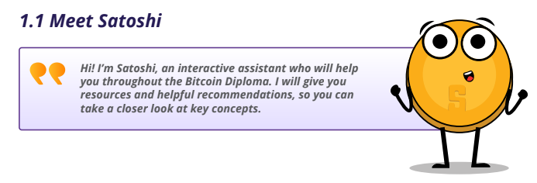

Slide 5
Why Do we need Money ?
Money may not directly equate to happiness, yet it offers vital security and peace of mind for individuals and their families. It serves as the means to access necessities such as housing, nutrition, healthcare, and education, all fundamental to sustaining life. While excessive wealth isn't imperative, financial resources are indispensable throughout one's lifetime. Hence, grasping the principles of personal finance becomes imperative, as it empowers individuals to handle earnings prudently and safeguard their futures, ensuring financial well-being even beyond their working years.

Slide 6
What is Money
Money represents a stable store of worth, capable of being exchanged for goods and services with ease and universal recognition. Throughout history, various items including cowry shells, salt, cocoa beans, gold, and silver have served as mediums of exchange.
What gives money its value
Fiat Money
Fiat money derives its value from the trust and confidence placed in it by individuals and the stability of the issuing government or central authority. Unlike commodity money, which has intrinsic value based on the material it's made of (like gold or silver), fiat money is not backed by any physical commodity. Instead, its value is based on the faith that people have in the government's ability to maintain its value and stability.

Slide 7
Intrinsic Value
Intrinsic value is the actual value or utility that an item has, regardless of its price or market value. It is often associated with tangible assets that have inherent usefulness, scarcity, or desirability. For example, precious metals like gold and silver have intrinsic value because they are rare, durable, and have industrial and aesthetic applications
Commodity Money
A commodity with intrinsic value refers to a physical item that possesses inherent worth or value due to its qualities, properties, or utility, independent of any external factors such as government decree.

Slide 8
What gives money its value
Fiat money derives its value from the trust and confidence placed in it by individuals and institutions, backed by the stability and credibility of the issuing government or central bank.
Commodity money derives its value from its intrinsic qualities, such as rarity, durability, and usefulness, rather than government decree.

Slide 9
THANK YOU

